Slide 1

Superintendent's Advisory Council for Instruction (SACI)
Monthly Meeting
March 14, 2024
KLC
Notes:
Bekah Schlatter

Slide 2
AGENDA
Welcome, Ms. Vanessa Olson, Chair
Old and New Business
Questions Follow-Up
Presentation: Family and Community Engagement
F. Yanet Boyd, Supervisor, Family and Community Engagement
Panel Discussion
Dena Hammad- School Parent Liaison, Bennett ES
  Jennifer Knapp- FACE Specialist, McAuliffe ES
  Elisa Dacales- School Parent Liaison, Gainesville MS
  Debra Woolfrey- FACE Specialist, Unity Braxton MS
  Melisa Pasero- School Parent Liaison, Colgan HS
  Erika Frazier- FACE Specialist, Gar-Field HS
Work Session: Annual Report
Adjourn
Notes:
BEKAH

Slide 3


Slide 4
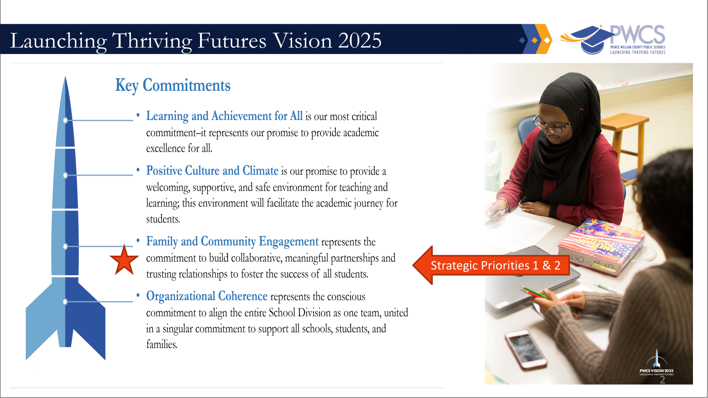

Slide 5
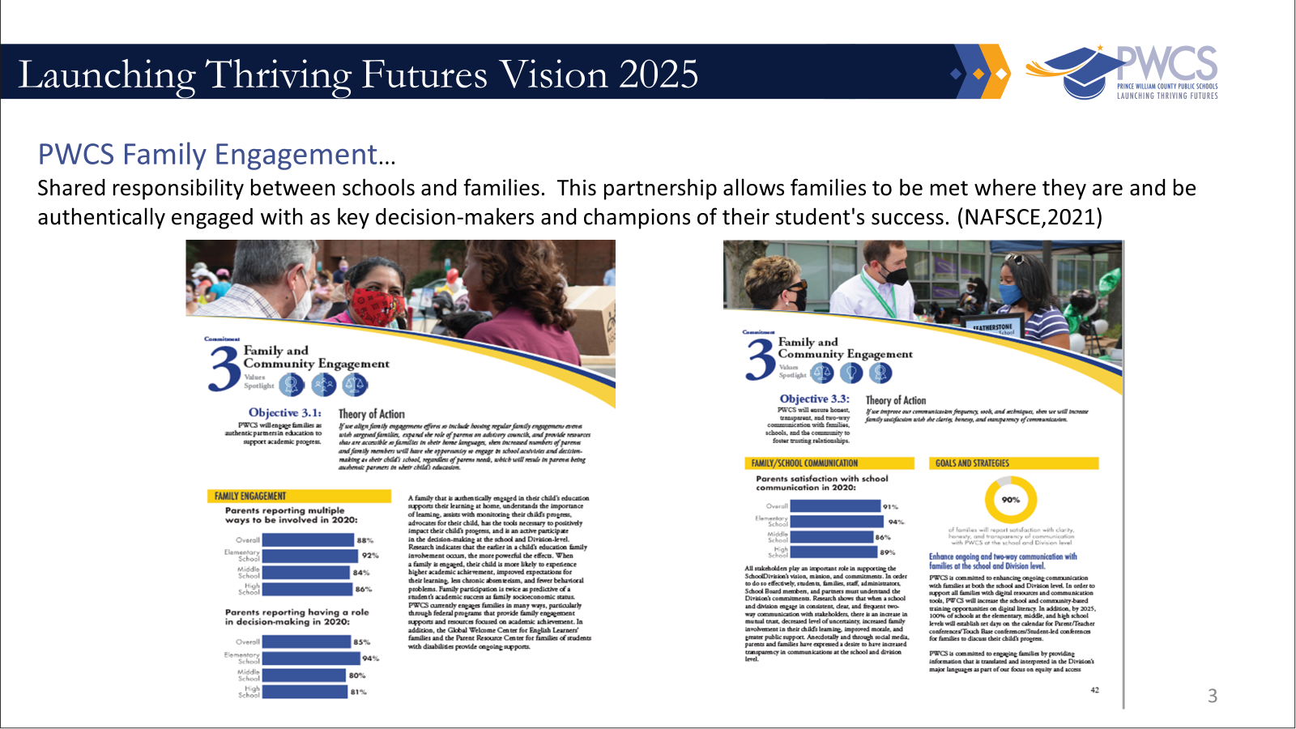

Slide 6
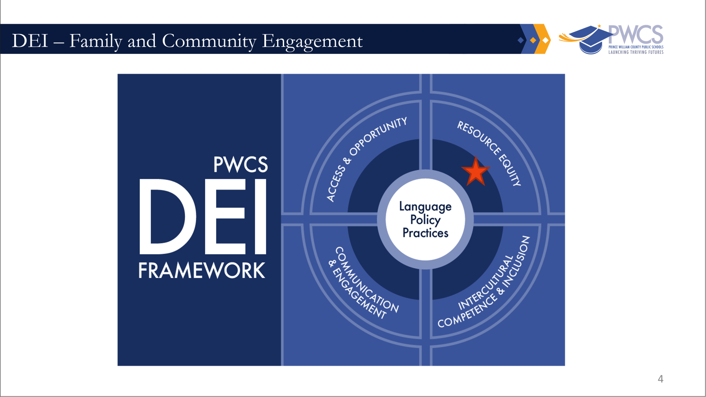

Slide 7
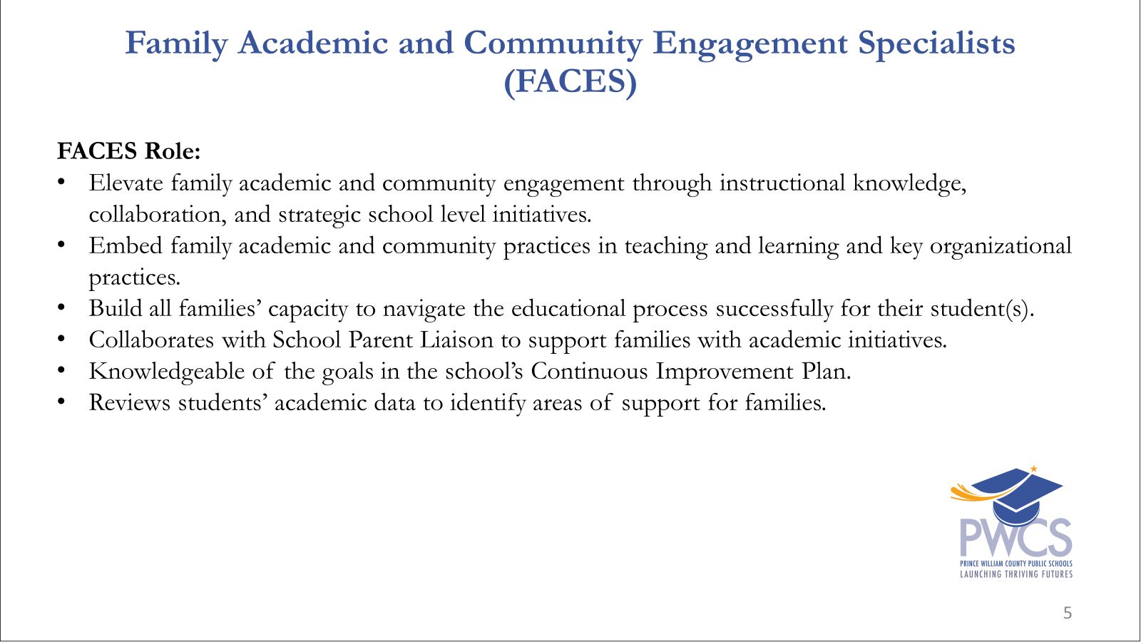

Slide 8
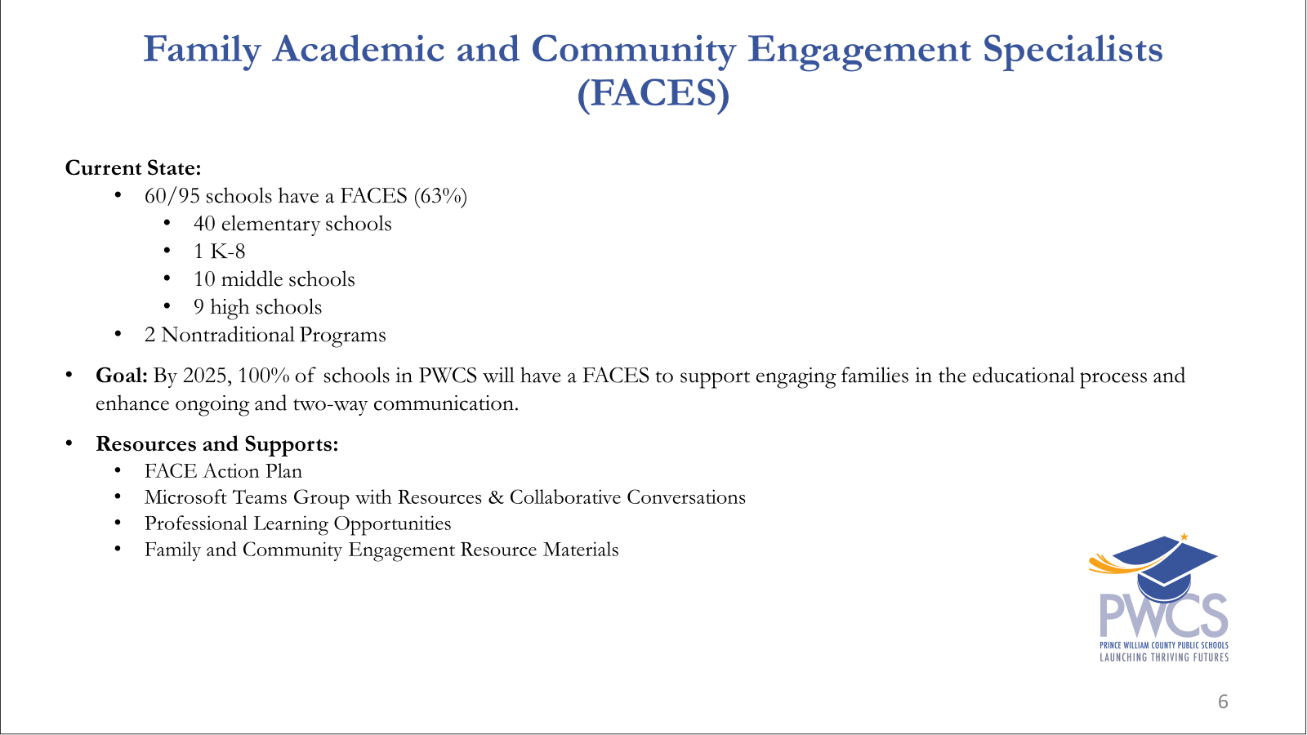

Slide 9
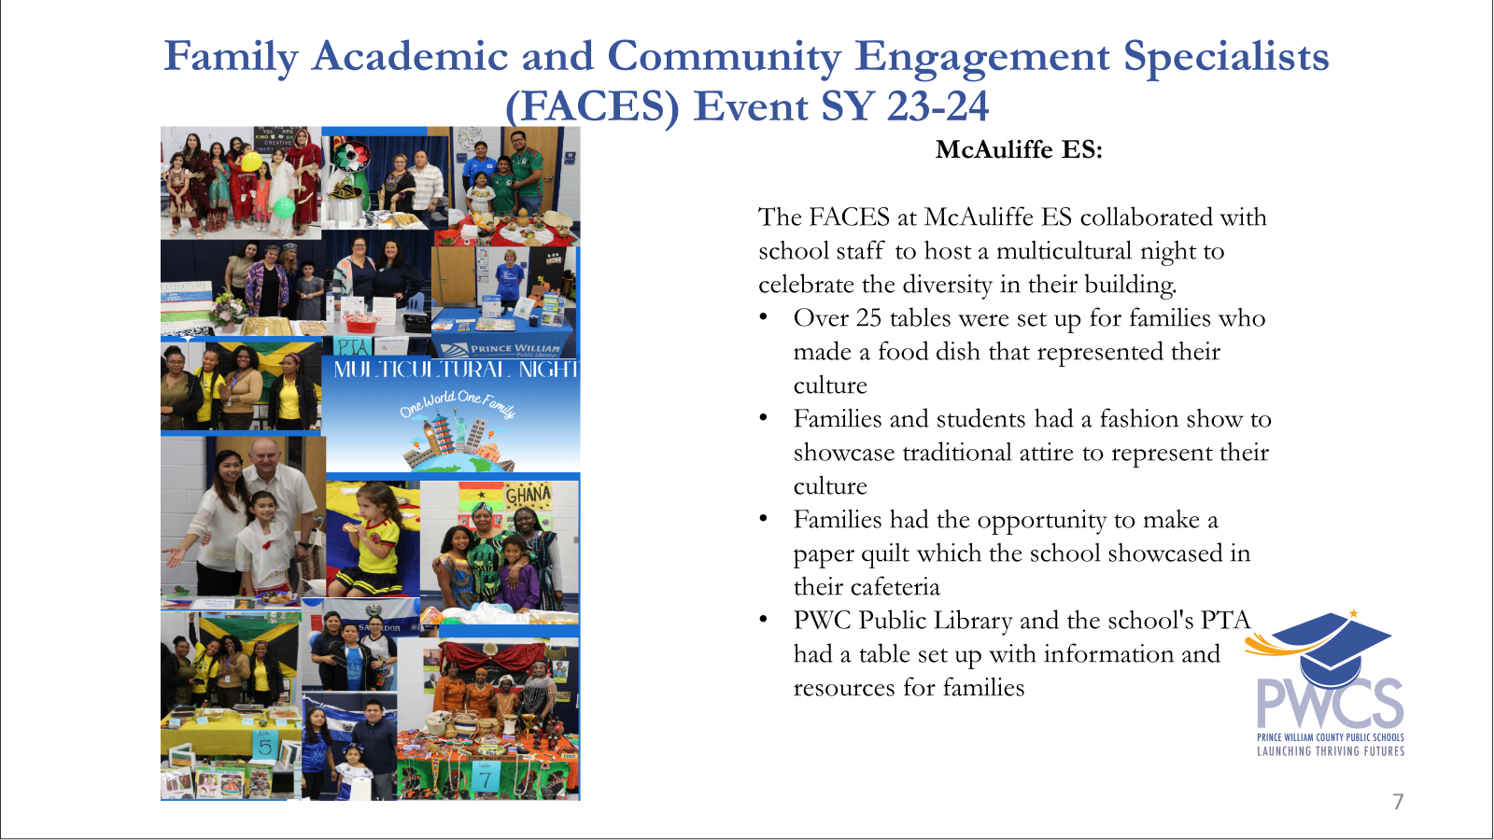

Slide 10
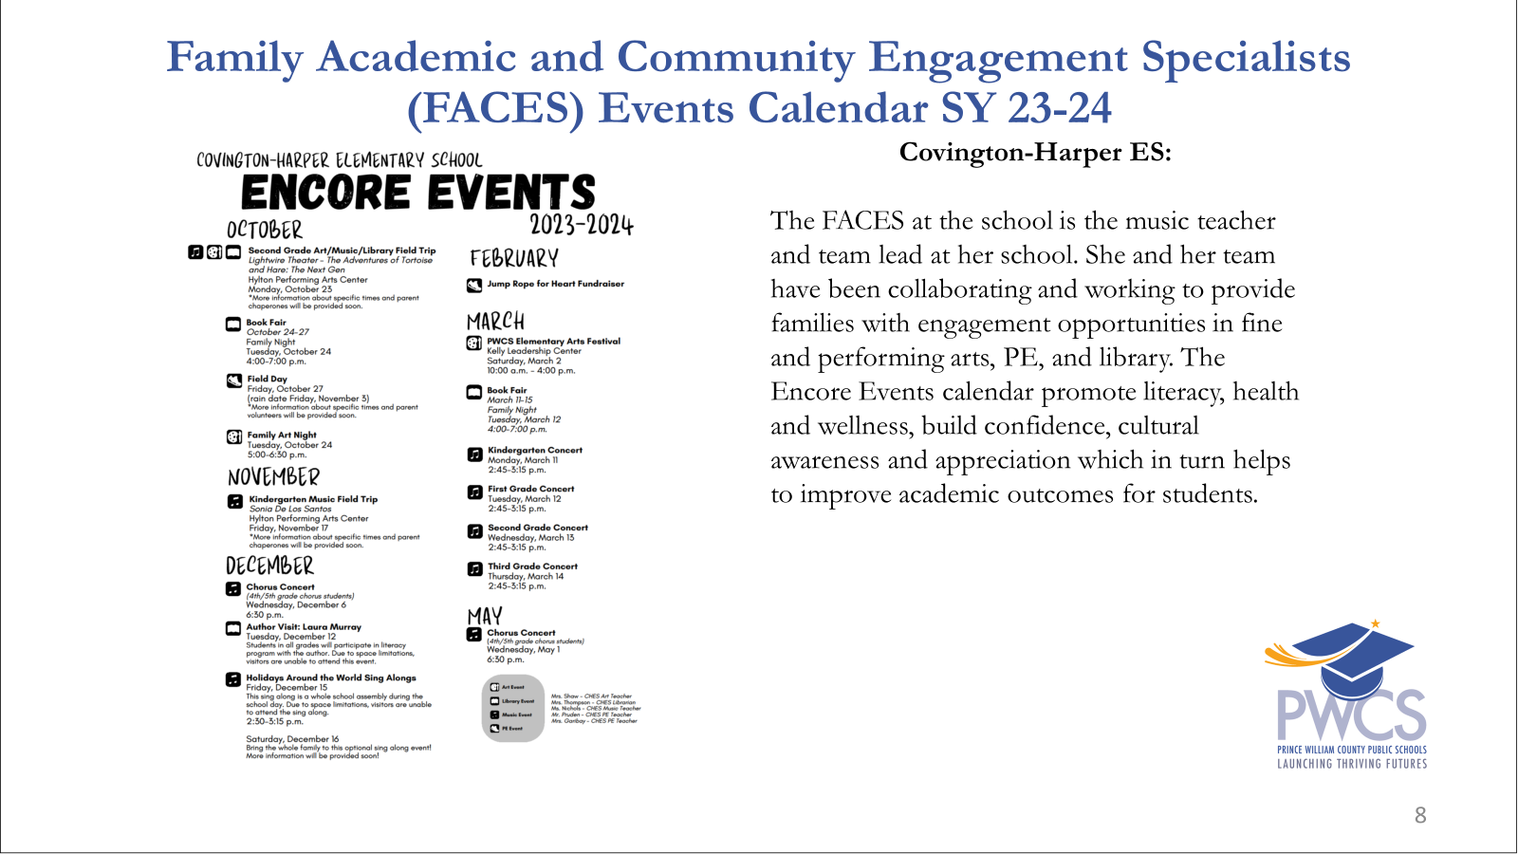

Slide 11
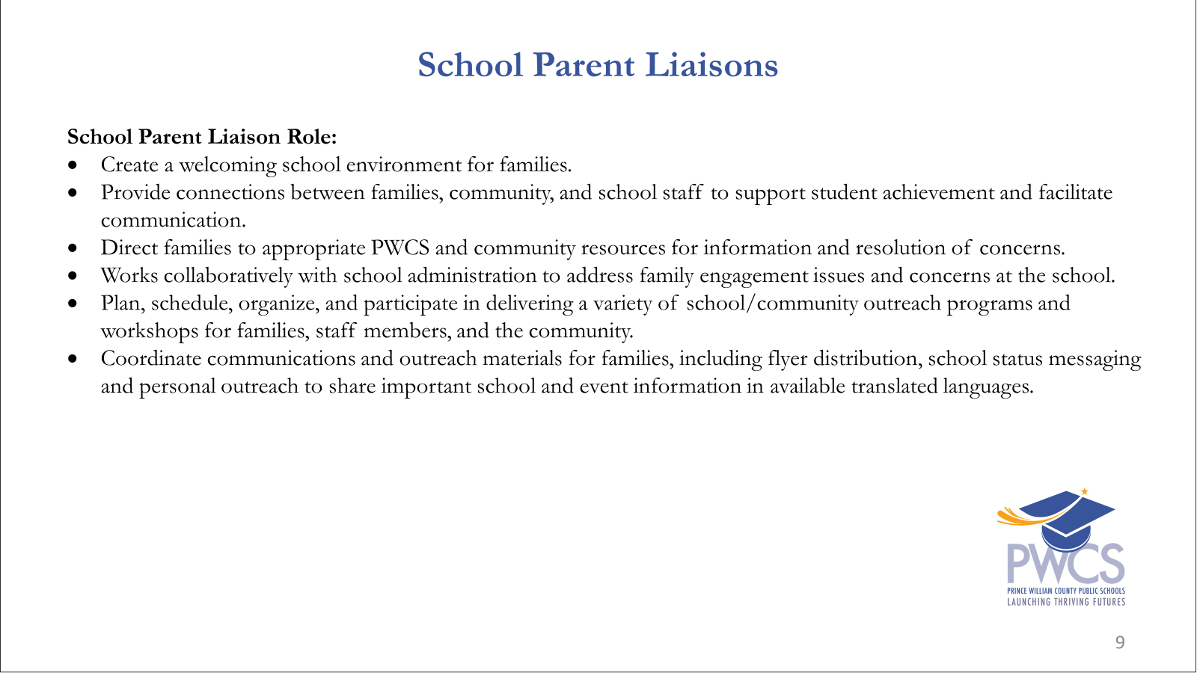

Slide 12
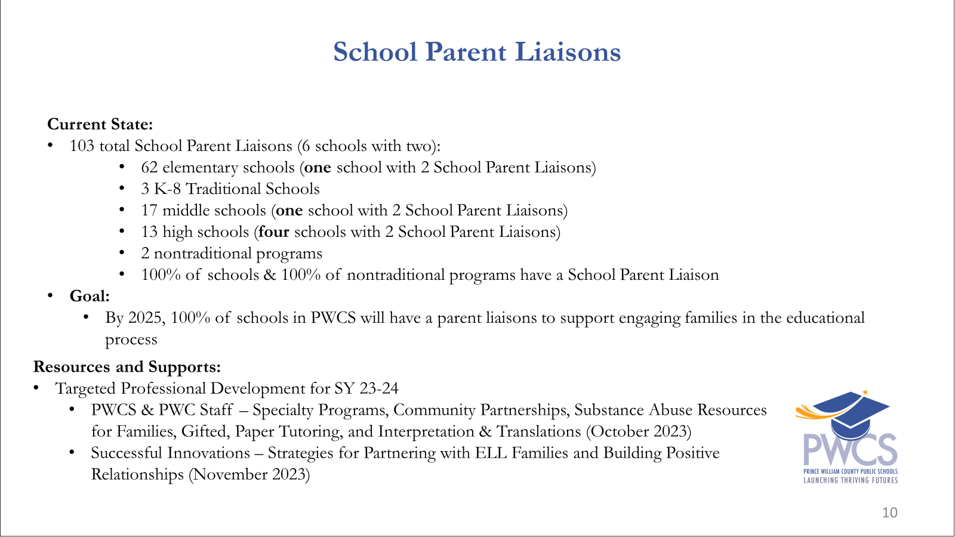

Slide 13
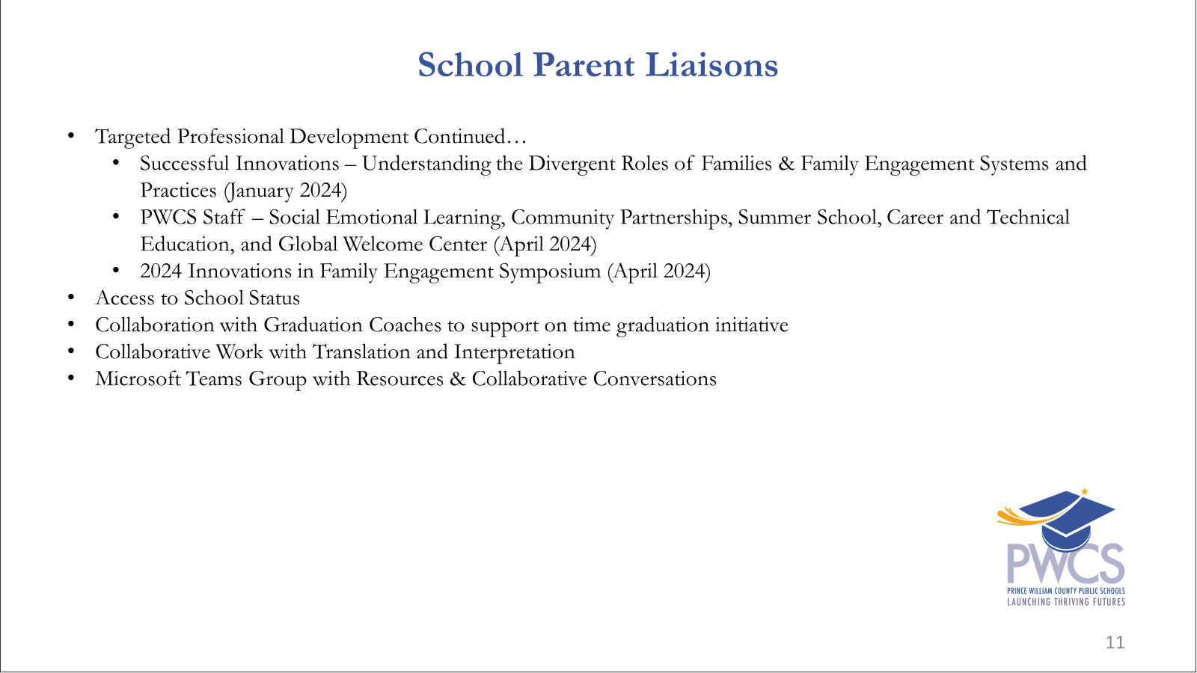

Slide 14
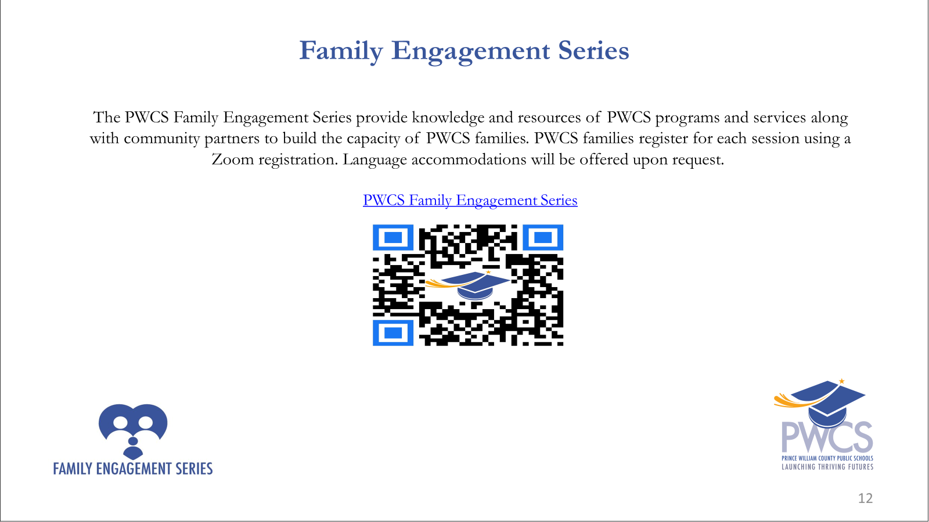

Slide 15
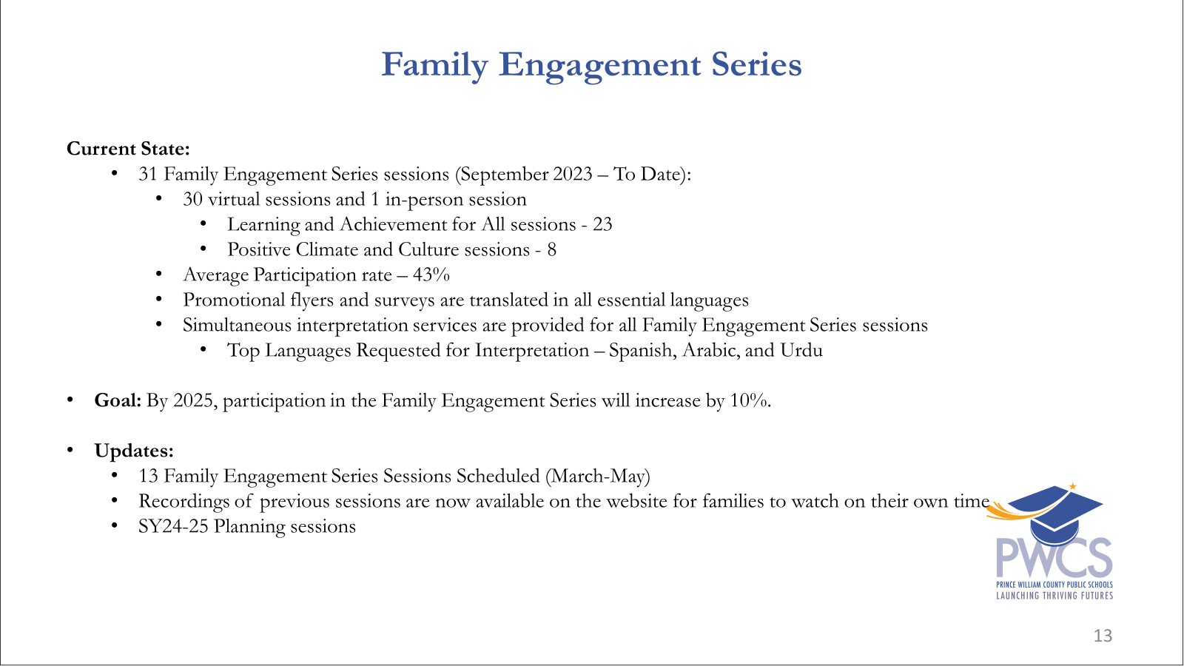

Slide 16
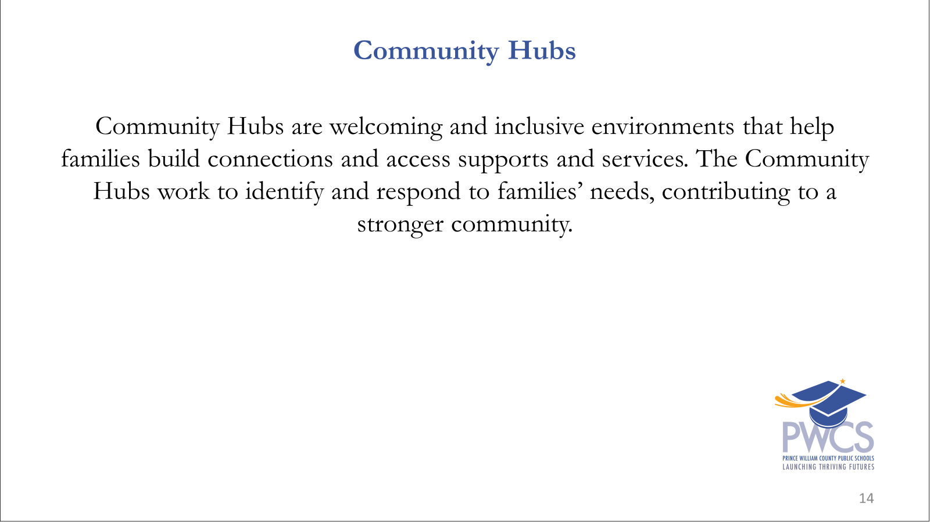

Slide 17
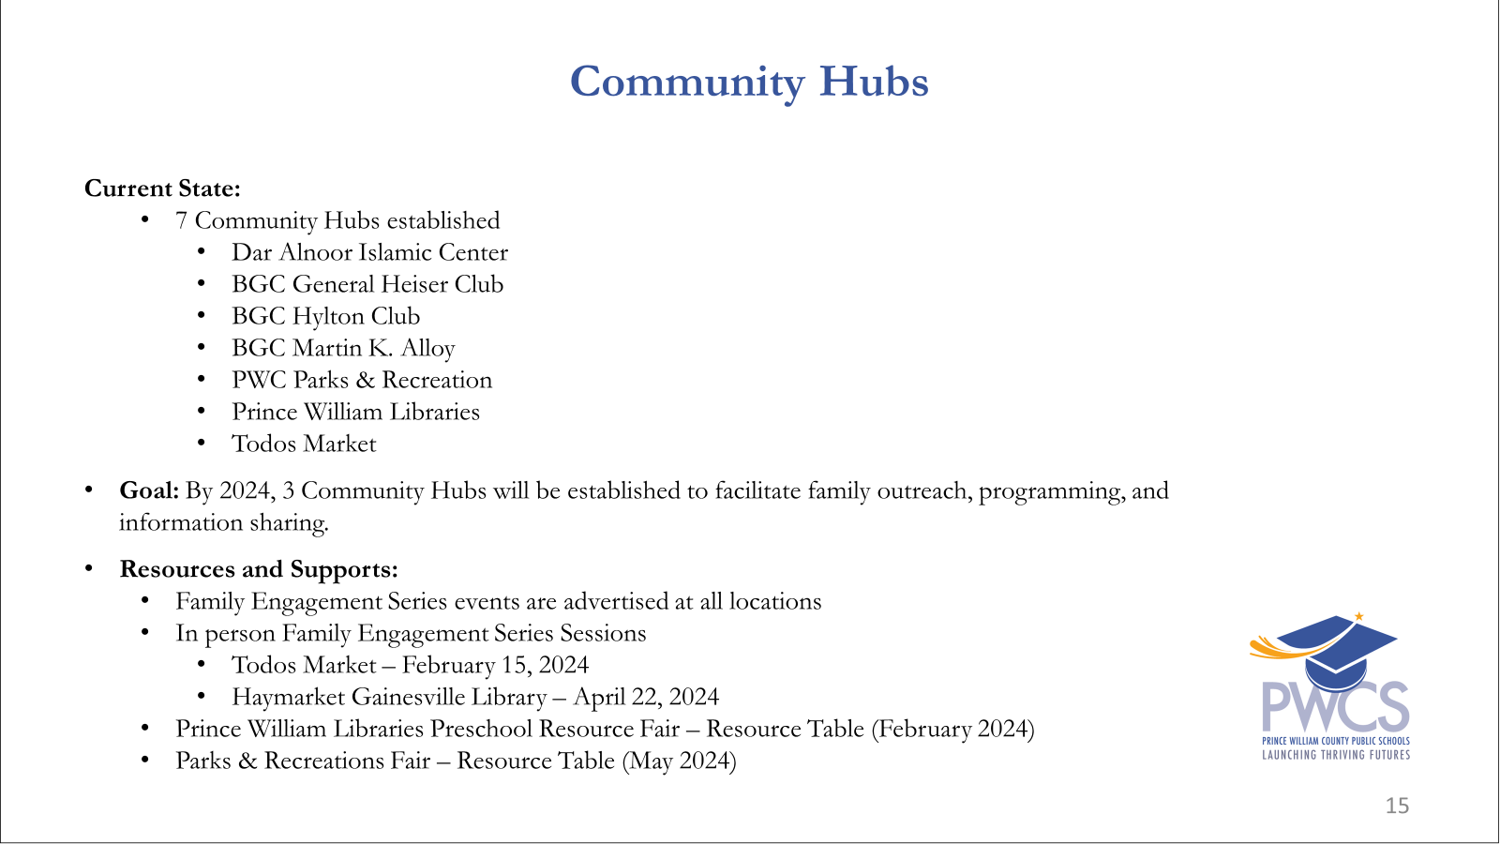

Slide 18
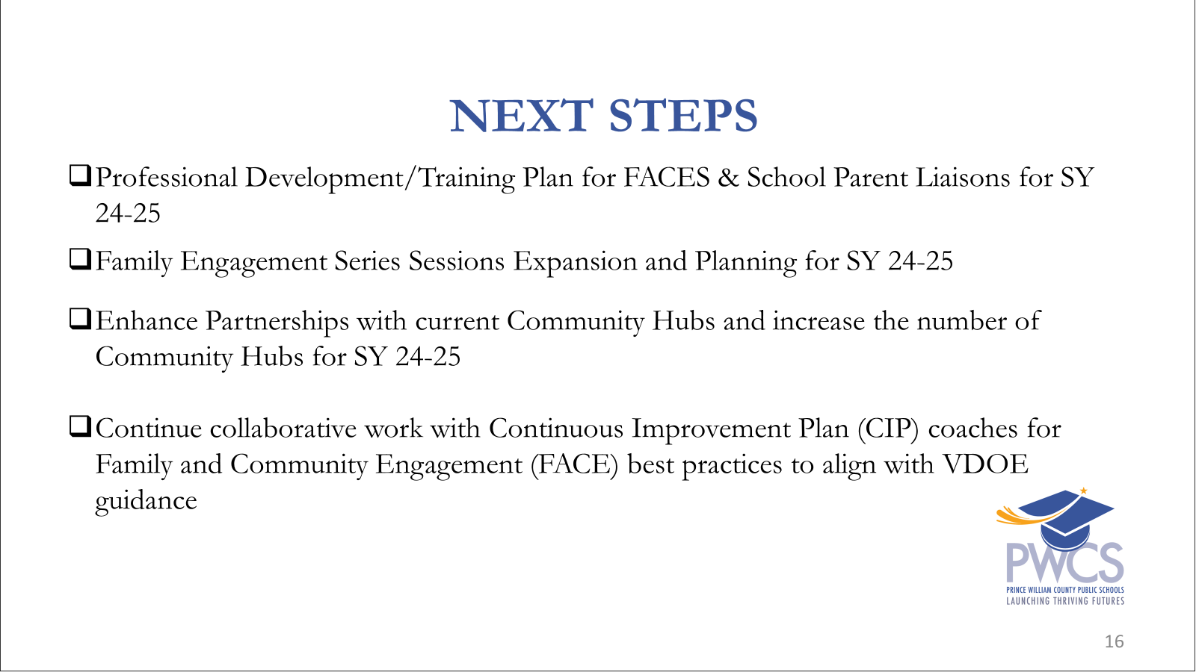

Slide 19


Slide 20


Slide 21
Panel Discussion
Welcome to our Panel Members
Dena Hammad- School Parent Liaison, Bennett ES
  Jennifer Knapp- FACE Specialist, McAuliffe ES
  Elisa Dacales- School Parent Liaison, Gainesville MS
  Debra Woolfrey- FACE Specialist, Unity Braxton MS
  Melisa Pasero- School Parent Liaison, Colgan HS
  Erika Frazier- FACE Specialist, Gar-Field HS
Notes:
BEKAH

Slide 22
Work Session:
Annual Report

