Slide 1
Superintendent's Advisory Council for Instruction (SACI)
Monthly Meeting
December 14, 2023
Colgan High School
Notes:
Bekah Schlatter

Slide 2
AGENDA
Welcome, Ms. Vanessa Olson, Chair
Old and New Business
Presentation 1: Special Education Overview
Dr. Ashley Reyher, Associate Superintendent for Special Education
Dr. Aimee Holleb, Director, Specialized Instruction
Dr. Wendy Martin-Johnson, Director, Programs and Development
Presentation 2: Special Education and Student Activities
Dr. Martin Grimm, Director, Student Activities and Athletics
Break
Presentation 3: Gifted Education Overview
Ms. Brenda Bailey, Supervisor of Gifted Education and Talen Development
Work Session
Positive Climate and Culture
Safety and Attendance
Adjourn
Notes:
BEKAH

Slide 3
Superintendent's Advisory Council on Instruction
Dr. Ashley Reyher, Associate Superintendent,
Office of Special Education
Dr. Aimee Holleb, Director,
Special Education – Specialized Instruction
Dr. Wendy Martin-Johnson, Director,
Special Education – Programs and Development
December 14, 2023

Slide 4
Agenda Introductions & Welcome Special Education Overview: The Eligibility Process Levels, Types of Services, and Settings for Students with Disabilities (SWD) Services for Students with Disabilities

Slide 5
PWCS Vision
All PWCS students will graduate on time with the knowledge, skills, and habits of mind necessary to create a thriving future for themselves and their community!
PWCS Vision 2025

Slide 6
The Eligibility Process Regulations Student Support Team/Intervention Team Child Find Responsibilities Parent Participation & Timelines Evaluation Eligibility Determination Areas of Disability Next Steps & the IEP

Slide 7
Regulations
Federal Law: The Individuals with Disabilities Educational Improvement Act (IDEIA)
Free Appropriate Public Education (FAPE)
Placement in the Lease Restrictive Environment (LRE)
Protection for the rights of children & their parents
State Regulations: Regulations Governing Special Education Programs for Children with Disabilities

Slide 8
Student Support Team/Intervention Team
Multidisciplinary, problem-solving team that meets to identify, implement, and make recommendations related to specific student needs.
Focuses on concerns related to: academics, behavior, & social-emotional
Decreases the likelihood over identifying students for special education services.
Upholds the obligation of ensuring proper identification of students when there is a suspicion of a disability.
Assist the teacher in identifying and implementing the instructional adjustments or behavioral supports necessary to enable the student to meet the demands of the school curriculum or environment​
Develops and documents a student support plan (SSP) to address those concerns ​
Monitors and documents the student's progress

Slide 9
Child Find Responsibilities
Child Find Process
Refers to the process that is initiated when a student is suspected of having a disability.
Responsibilities:
Locate, identify, and evaluate children residing in Prince William County, ages 2-21 inclusive, who are in need of special education services ​
Provide public awareness ​
Conduct screenings ​
Review and respond to referrals for interventions

Slide 10
Parent Participation & Timelines
Parental Participation​
Parents must be provided an opportunity to participate meaningfully in meetings concerning their child's special education identification, evaluation, educational placement, and the provision of FAPE.
Timelines
If a disability is suspected, the Child Find Team (CFT) must meet within 10 business days of receipt of the referral by the school administrator or administrative designee.
An evaluation, if initiated, must be completed within 60 business days of the date of the receipt of the referral by the administrator.
The eligibility determination meeting must be held within the same 60 business days.

Slide 11
Evaluation
Procedures:
Conduct a review of existing data
Determine the need for additional data
Obtain parental consent
Convene within 60 business days to determine eligibility
Evaluation Reports:
Must be:
Written
Available for parents to review 2 business days before the meeting
Provided to the parent at no cost at the meeting
Include results which are related to the reason for referral
Contain implications for appropriate educational interventions

Slide 12
Eligibility Determination
Convene the meeting
Consider existing information
Review the evaluation results
Consider all data presented
Complete relevant criteria worksheets
Identify the disability(ies) for which the student meets criteria
Document the discussion
Decide if the student is eligible based on the results of the evaluations, the student's educational record, parental input, and the completion of the criteria worksheets.

Slide 13
Areas of Disability
Autism
Deaf-Blindness
Developmental Delay
Emotional Disability
Hearing Impairment
Deafness
Intellectual Disability
Multiple Disabilities
Orthopedic Impairment
Other Health Impairment
Specific Learning Disability
Speech or Language Impairment
Traumatic Brain Injury
Visual Impairment Including Blindness

Slide 14
Next Steps
If the student is eligible, within 30 days, an IEP team needs to convene to develop an IEP (Individualized Education Program)
IEPs are developed annually
IEPs can be amended as needed
Reevaluations are every 3 years & the process is called a triennial
If the student is ineligible, the team can refer the student back to the Student Support Team for continued interventions

Slide 15
Services for Students with Disabilities Levels Types of Services Settings

Slide 16
What levels/types of services are provided to students and in which types of settings?
Free and Appropriate Education in the Least Restrictive Environment – FAPE in the LRE
Focus on access to general education setting to the maximum extent appropriate –
What specially designed instruction (SDI) does the child require to be able to access the grade level standards?
When and who provides such SDI to supplement General Education, standards-based instruction?
Examples: gen ed, resource, co-teaching, pull out, small group

Slide 17
Types of Services
Early Childhood Special Education
Children of preschool ages (2 to 5, inclusive) who are eligible. The amount of services is determined by the child's IEP (Individualized Education Program) team (examples – resource or class-based)
Resource Level Services (students with high incidence disabilities accessing the general curriculum, e.g. - SLD, OHI, ED, Autism)
Students with disabilities served in the special education setting for less than 50% of their instructional day (excludes meals). The time is calculated based on special education services described in the IEP, rather than location of services.
Specialized Programs (known as Level 2) - Autism, ED, ID, IDS
Students with disabilities served in the special education setting for 50% or more of their instructional day (excludes meals). The time is calculated based on special education services described in the IEP, rather than location of services.

Slide 18
Types of Services
Services may be delivered in a variety of ways...
Related services – example – transportation, speech-language, audiology, interpreting, Physical Therapy (PT), Occupational Therapy(OT), counseling, school health services, social work, etc.
Itinerant services example – OT, PT, Assistive Technology (AT) , Orientation and Mobility(O&M), Vision, Deaf/ Hard of Hearing (D/HH), etc.
Resources services – example – SED push-in, pull out, etc.
By a variety of people...
Example - Sped Teachers, OT, PT, AT, O/M, Vision, D/HH, School Counselor, Social Worker, School Psychologists.....

Slide 19
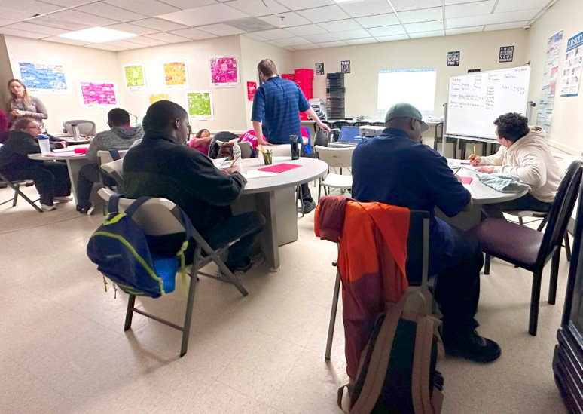
Celebrations with Transition Services
We are focused on:
Supporting SWD with on-time-graduation through:
Ensuring our special education teachers & transition specialists are focused on including discussion on SATs/PSATs in each student's course of study
Developing replicated work-based learning sites to support students learning employment skills in workplace settings to include:
UVA Medical Center
TODOs Market
24-25 Tentative SEARCH location
24-25 Tentative Assisted living facility
Collaboration between school psychologists and school social workers on key areas of focus to support students as SBQMH

Slide 20
Regional Program - D/HH
PWCS proudly boasts the Regional Program for D/HH -
Manassas City Public Schools, Manassas Park Public Schools, PWCS
Option for students when IEP teams endorse that the child could benefit from being grouped with other students served by D/HH staff (Coles ES, Benton MS, Colgan HS).
Memorandum of Understanding between the PWCS School Board, Manassas City School Board, Manassas Park City School Board – Establishing the Northern Virginia Students with Intensive Support Needs Application (SISNA) Partnership

Slide 21
Priorities for Special Education in PWCS
Enhancing special education services in PWCS
Inclusive practices and Least Restrictive Environment (LRE)
Support for new teachers, TAs, TPOTAs
ECSE inclusion and instruction
Continued increase in parent/family engagement
Supporting school staff with the IEP process
Focused on the increase in Child Find for children ages 2-5

Slide 22
Questions/Answers

Slide 23
PWCS Clubs, Activities,
Athletics, and Unified
Sports Update
Dr. Martin Grimm
Director, Student Activities & Athletics

Slide 24
Today’s Learning Outcomes
Review Questions from the Committee
Review support of Unified Sports and Unified Sports Events

Slide 25
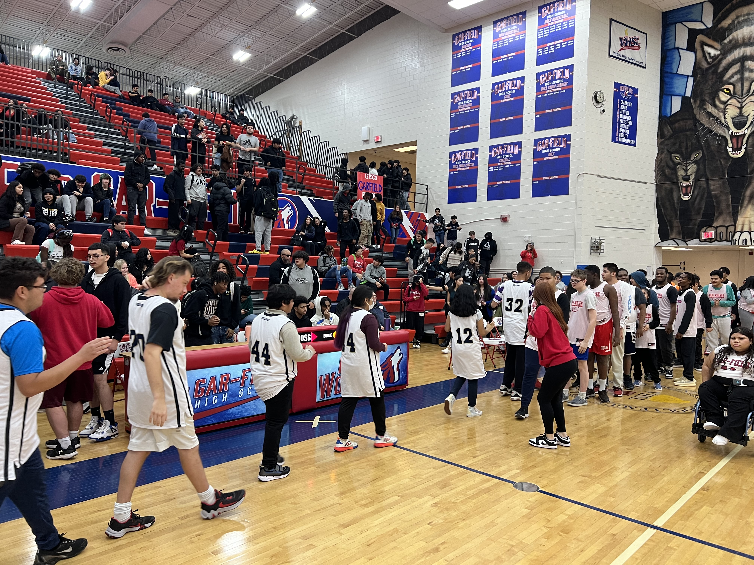
Questions Submitted
What types of activities the students are involved in?
Students participate in all Virginia High School League (VHSL) activities and athletics.
Students can participate in our 331 approved clubs across PWCS.

Slide 26
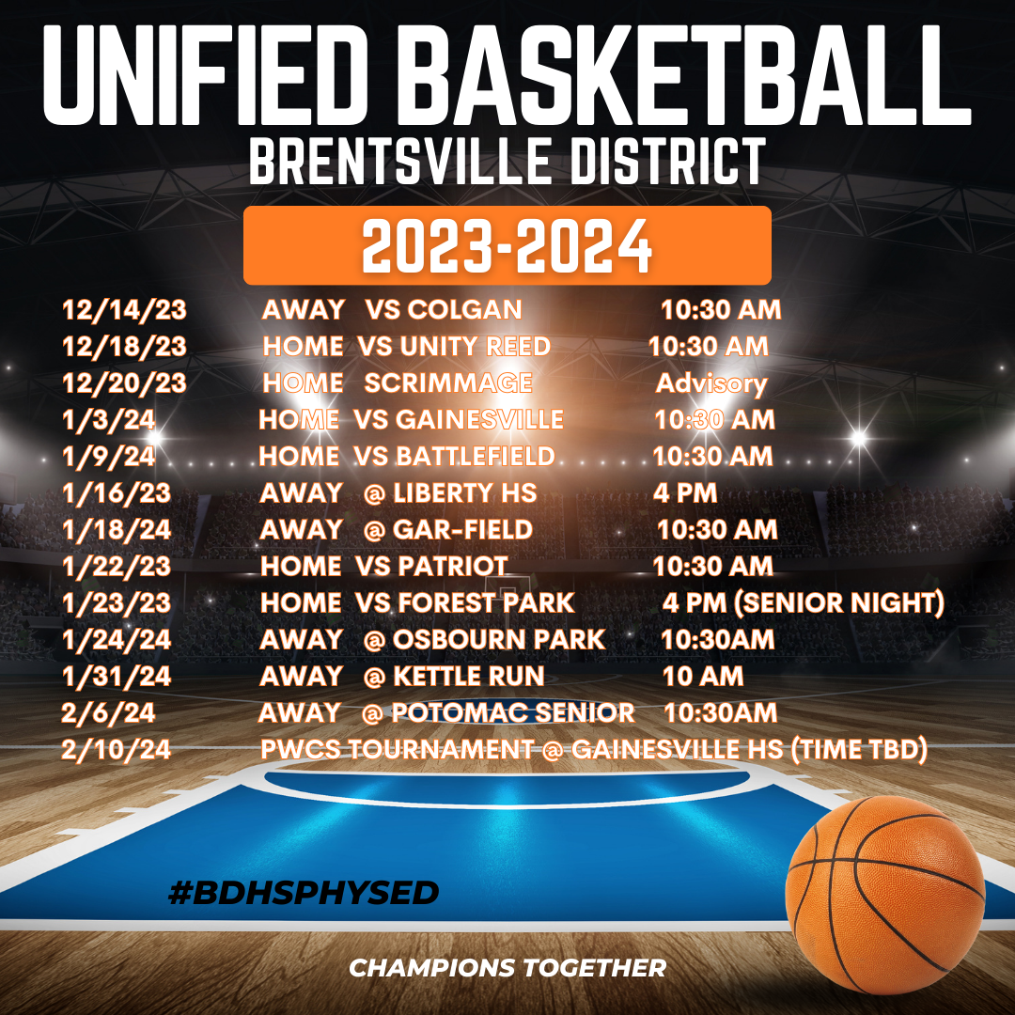
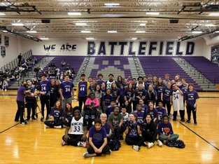
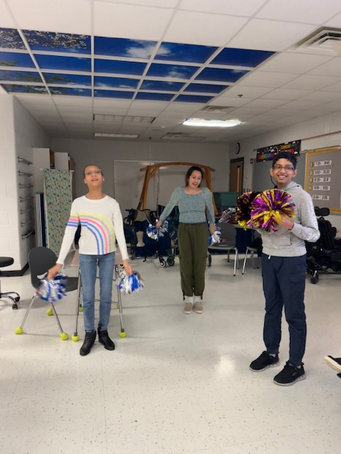
Questions Submitted
Are students provided accommodations as needed for participation?
Yes, schools work closely with IEP teams and when requested, Dr. Grimm and Ms. Ausborn (Coordinator for Sports Medicine) work with schools to provide additional support.
Is it clear to students with disabilities how to access activities?
Schools advertise clubs, activities and athletics throughout the year.

Slide 27
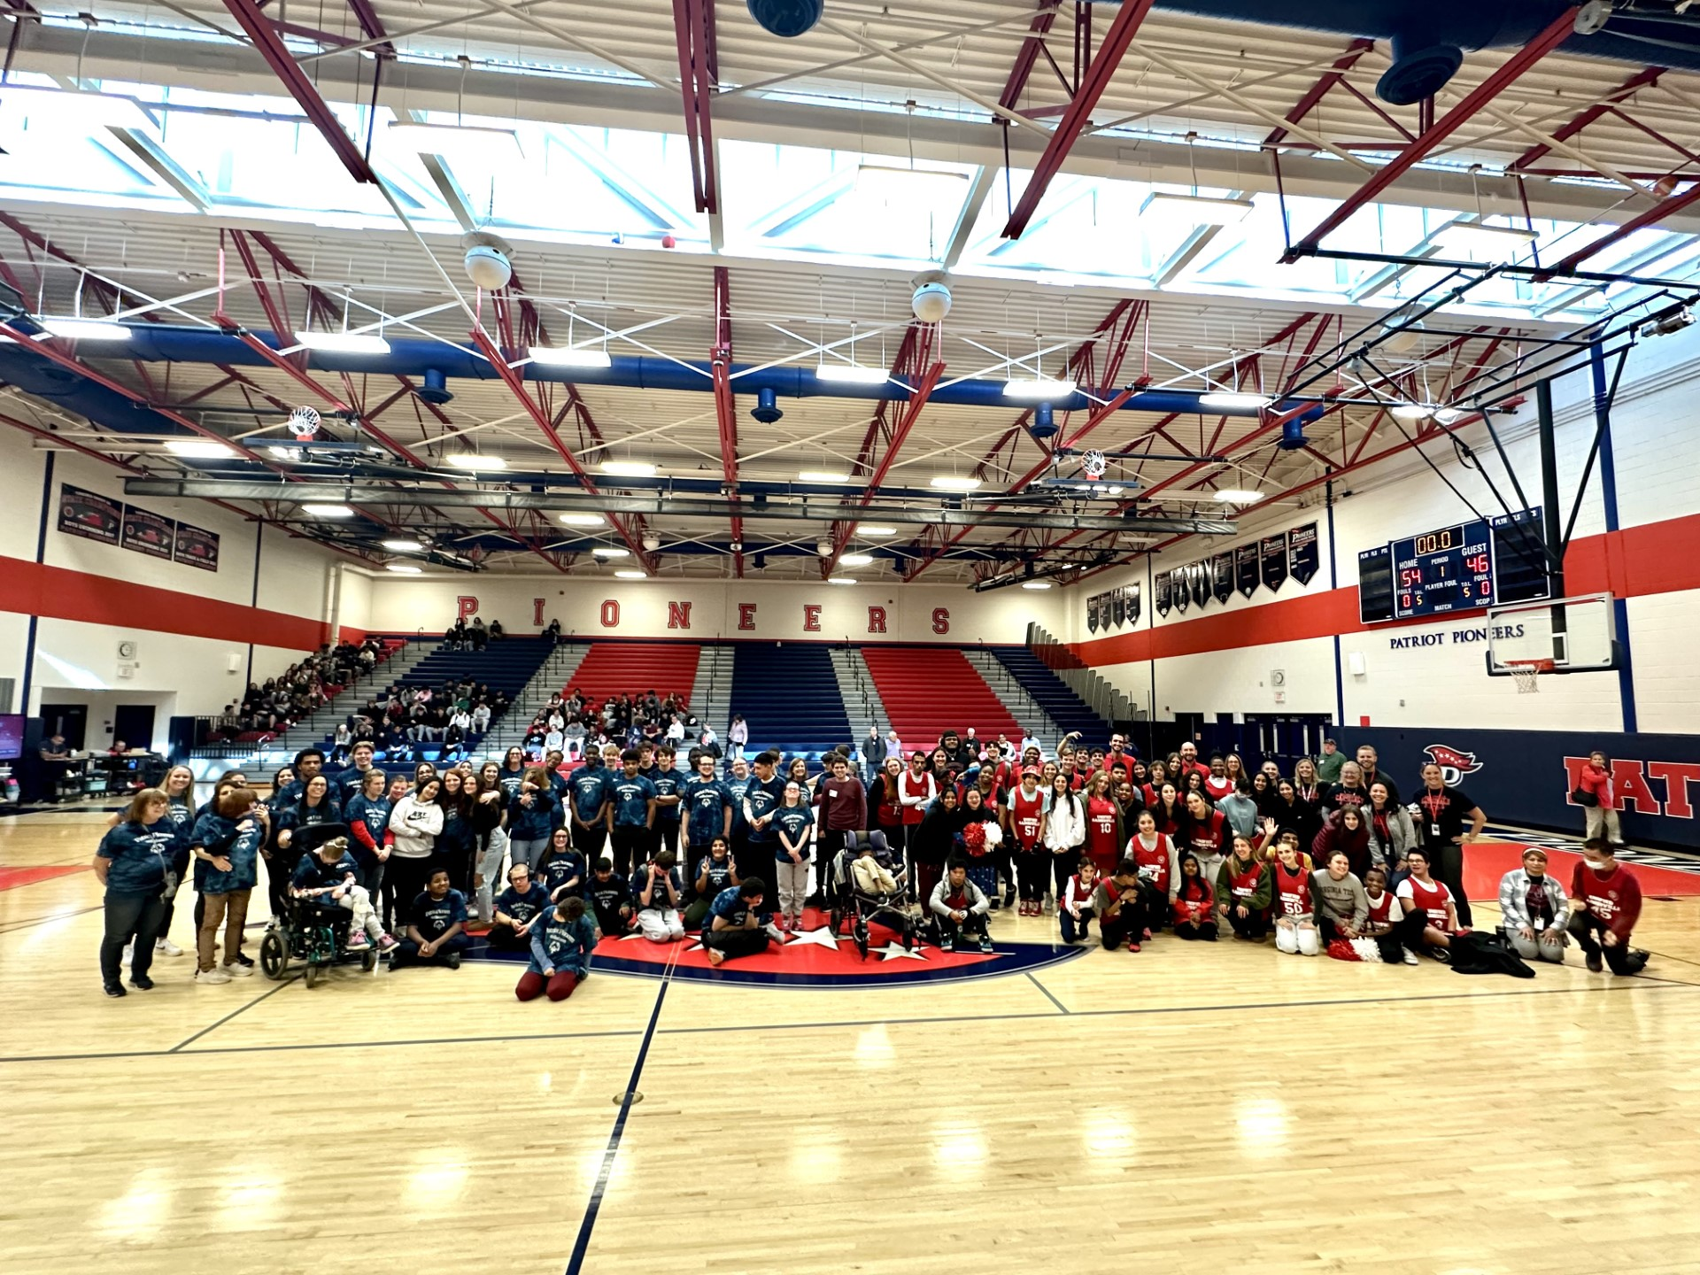
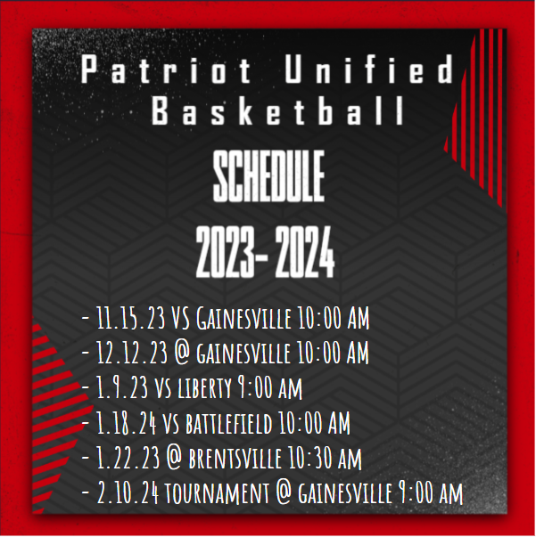
Unified Sports
Unified sports allows for modifications and accommodations to athletic programs and is inclusive of both general education and special education students.

Slide 28
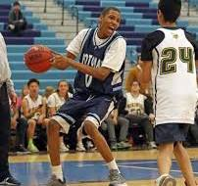
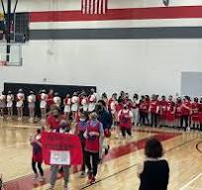
Unified Sports
Two coaching supplements have been approved and are available for our Unified Sports coaches.
Head Coach
Assistant Coach

Slide 29
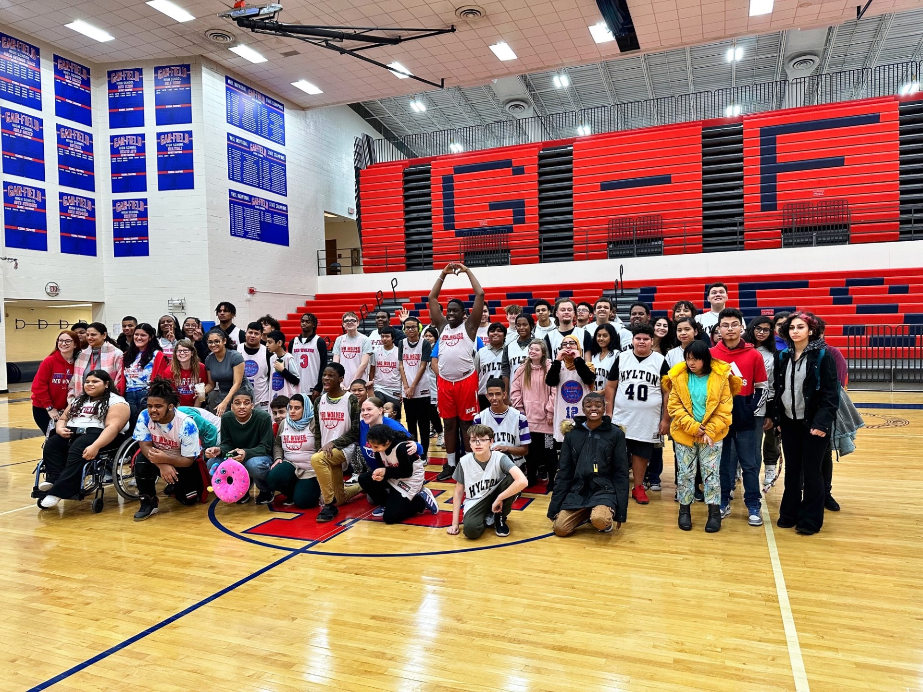
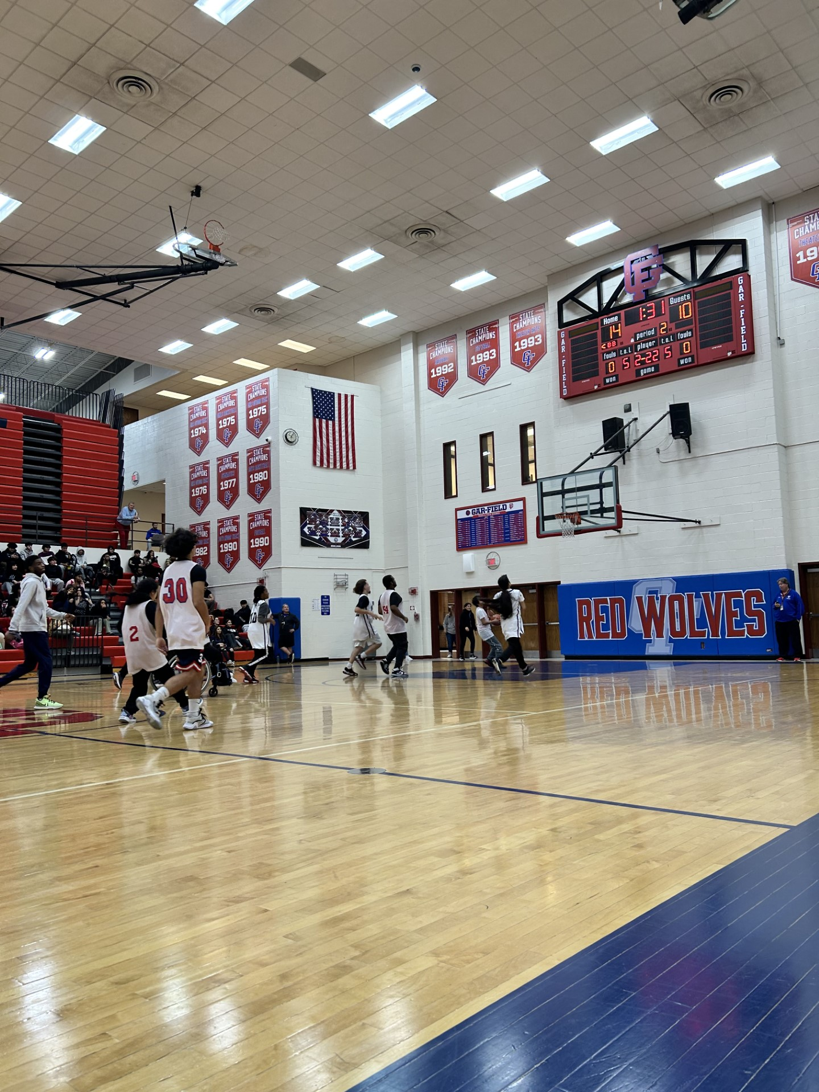
Unified Sports
Funds have been set aside for tournaments with the goal of enhancing experiences for our student-athletes.

Slide 30
Questions/Answers

Slide 31
Gifted at a Glance:
A Guide to Gifted Education
and Talent Development
Superintendent's Advisory Council on Instruction
December 14, 2023
Brenda Bailey
Supervisor of Gifted Education
and Talent Development
baileybs@pwcs.edu

Slide 32
Agenda
Definition of “Gifted”
Look-Fors at Home
Gifted Education and Talent Development Program and Goals
Identification Process
Q&A

Slide 33
Definition of “Gifted” Students
Students who demonstrate high levels of accomplishment or show exceptional academic potential beyond their age peers of similar experience or environment in:
General Intellectual Aptitude (K-12)
Language (K-12)
Mathematics (K-12)
History and Social Sciences (6-12)
Science (6-12)

Slide 34
Look-Fors at Home
Curious, questioning attitude, keen observer
Vivid imagination
Learns quickly
Sophisticated sense of humor
Exceptional memory
Sensitive to human issues, fairness, justice
Strong communication skills
Motivated to learn or develop a skill
ELs – quick to learn 2nd language
Intense interests
Enjoys problem solving with numbers and puzzles

Slide 35
What is the Gifted Education and Talent Development Program?
​Resource services for students whose advanced learning needs cannot be entirely met in the general education classroom
Identified students work with a gifted resource teacher on a regular basis during the school day.
Students engage in challenging units of study, independent projects, and seminars designed for gifted/advanced learners.
Subject to Virginia Regulations Governing Educational Services for Gifted Students
Outlined in PWCS 2022-27 Local Plan

Slide 36
Goals of Gifted Education
and Talent Development
To develop advanced skills in…​
​Critical Thinking​
Creative Thinking ​
Communication​
Collaboration​
Conceptual Thinking ​
​
in order to…

Slide 37
Goals
Grow independent thinkers and learners, informed and supportive collaborators, and exceptional leaders.
Prepare students for advanced coursework, dual enrollment classes, post-secondary education, and future careers.

Slide 38
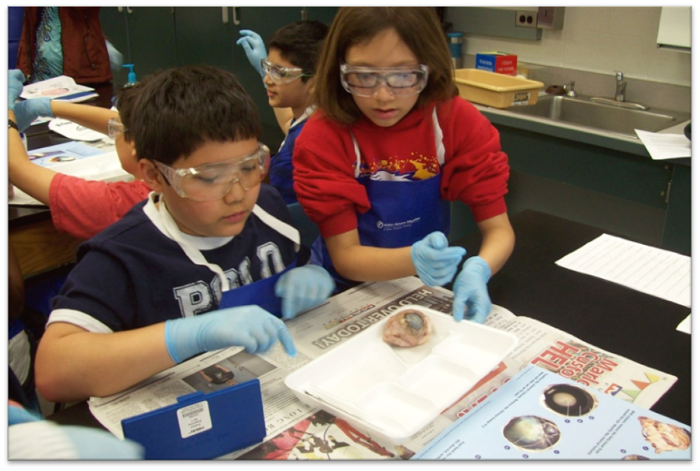
Elementary School
On-site gifted services with at least one full-time gifted resource teacher at every school
Direct resource services:
Kindergarten – 25 min/week
Grades 1 and 2 – 45 min/week
Grade 3 – 90 min/week
Grades 4 and 5 – 225 min/week
Cluster-grouped in classrooms with gifted accredited teachers
Yearly Differentiated Services Plans (DSP)
Semester progress reports

Slide 39
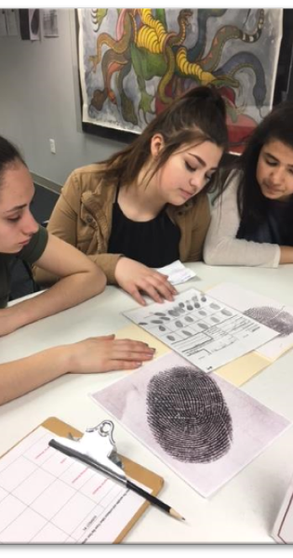
Middle School
On-site gifted services with at least one full-time gifted resource teacher at every school
Direct resource services:
6th/7th grade – Two quarters per year on the arts rotation
8th grade – Pull-out resource services (25 hrs/year) or one quarter on the arts rotation
Extended Math and Extended Language Arts, HS credit classes
Yearly Differentiated Services Plans (DSP)
Quarterly progress reports

Slide 40
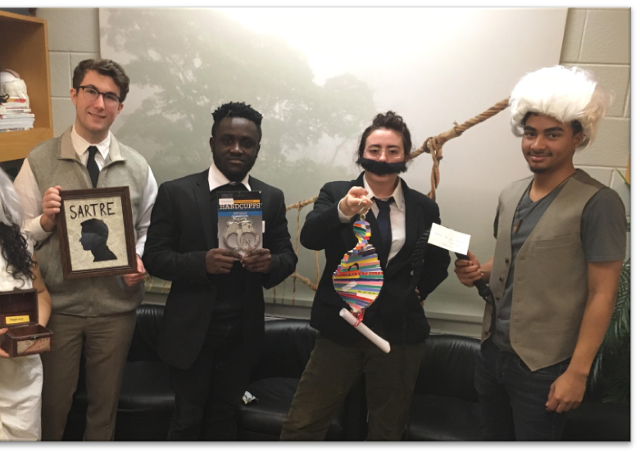
High School
On-site gifted services at every high school
Direct resource service options:
18 hrs/year of Socratic Seminars
Gifted Education Multidisciplinary Seminars (GEMS) course
AP Seminar/AP Research
IB Theory of Knowledge (Gar-Field/Unity Reed)
AICE Thinking Skills & Global Perspectives (Brentsville/Potomac)
School Year Governor’s Schools: GS@IP, Thomas Jefferson
Summer Residential Governor’s Schools

Slide 41
Differentiation in the Classroom
Differentiated Services Plans (DSP) outline collaboration between classroom teacher(s) and gifted resource teacher to extend and enrich curriculum
Gifted accreditation requirement for classroom teachers
18 hours of professional development
Required topics include characteristics and needs of gifted learners, differentiation strategies, and identification
Virtual and face-to-face options, book studies, podcasts
Professional learning for Instructional Coaches
Collaboration with content areas to embed extensions into curriculum guides
Push-in enrichment lessons led by gifted resource teachers to model differentiation strategies

Slide 42
Multicriteria Identification Process

Slide 43
Multicriteria Identification Process
A wide variety of data is included in the identification process.
No single piece of data may either include or exclude a student from the program.
Process can take up to 90 instructional days.
​
​
​

Slide 44
Referral
Permission
No evidence will be collected until parent/guardian permission is received.
Professional;
Collection of Evidence
Aptitude test results;
Academic record;
Parent and student reports;
Student work products, math problem set, controlled writing, norm-referenced achievement data.
Parent;
Self; and
Universal screening/data review.
Includes school-based administrator, school counselor, classroom teachers, gifted resource teacher.
Written notification of decision is mailed home.
Include specialists (ESOL or Special Education), as needed.
Meets to review evidence and make decisions about gifted eligibility and placement for services.
IDP
Committee
Decisions are reviewed and verified by Division-level Oversight Committee.
Professional reports; and

Slide 45
Parent Referral
Referral form initiates the identification process
May be submitted at any time during the school year
Available on the PWCS website - Gifted Education and Talent Development
Submit form to your child’s teacher or email it to GiftedEducation@pwcs.edu
​
​
​

Slide 46
Professional Referral and Universal Screening
Student's academic achievement or potential stands out among his/her peers.
We want to take a closer look at strengths and learning needs to determine if gifted education services are appropriate
Professional referrals can come from teachers, specialists, counselors, and administrators
Universal screening:
Naglieri Nonverbal Ability Test (NNAT)- Grades 2, 6, 9
Cognitive Abilities Test (CogAT) – Grade 3
2023-24
Divisionwide Testing
Oct. 23 – Nov. 30
Referral

Slide 47
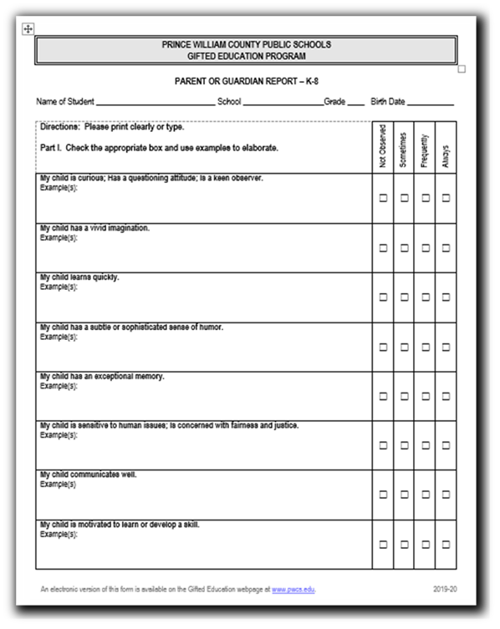
Permission
​
​
​
Permission
Permission for Evaluation
Parent Report

Slide 48
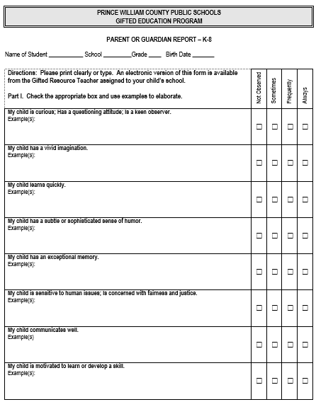
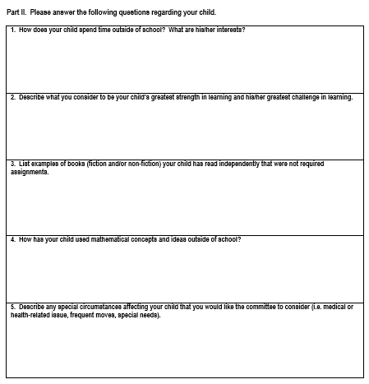
A Closer Look at the Parent Report
​
​
​
Matches “Look Fors at Home”
Gives parent an opportunity to highlight child’s strengths
Electronic version available online
Translated into multiple languages
May be completed as an interview

Slide 49
Collection of Evidence
Aptitude test scores
CogAT, NNAT, Kaufman Brief Intelligence Test (KBIT)
Achievement data
SOLs, PALs, PSAT, controlled writing, math problem set
Professional input
Classroom teachers, specialists (ESOL, special education) who work with the student complete reports
Parent and student input
Parent report, student response, student work samples, self-initiated project
​
Collection of Evidence

Slide 50
Identification/Placement (IDP) Committee
Consists of administrator, school counselor, classroom teachers, gifted resource teacher, and specialists (as needed) at the school.
Reviews evidence and discusses the student’s strengths as a learner.
Determines if evidence supports the need for gifted services.
The case is then sent to the Division-level Oversight Committee. This committee confirms that procedures were followed correctly and, if so, verifies the school committee’s decision.
IDP
Committee

Slide 51
Decision Options
​
​
Student may be found eligible for services, and the committee then decides what services are required.
Student may be monitored for further information before a decision can be reached.
Student may be found ineligible.
Student in K-2 may be recommended for the Early Talent Development (ETD) program.
IDP
Committee

Slide 52
Early Talent Development (ETD) Program
Recommended for students in Kindergarten – 2nd grade with potential for gifted identification
Classroom and gifted resource teachers collaborate to provide enrichment and extension activities to foster student talents and strengths
ETD portfolios document student growth
Re-evaluation by the end of 3rd grade

Slide 53
Referral
Permission
No evidence will be collected until parent/guardian permission is received.
Professional;
Collection of Evidence
Aptitude test results;
Academic record;
Parent and student reports;
Student work products, math problem set, controlled writing, norm-referenced achievement data.
Parent;
Self; and
Universal screening/data review.
Includes school-based administrator, school counselor, classroom teachers, gifted resource teacher.
Written notification of decision is mailed home.
Include specialists (ESOL or Special Education), as needed.
Meets to review evidence and make decisions about gifted eligibility and placement for services.
IDP
Committee
Decisions are reviewed and verified by Division-level Oversight Committee.
Professional reports; and

Slide 54
Appeals Process
Parents or professionals may appeal the committee’s decision within 10 instructional days of notification.
The Appeals Committee:
Conducts an in-depth review of student case
Asks questions, considers new evidence
Requests additional data or information, as needed
Renders a decision
Contact the Gifted Resource Teacher to review student’s collection of evidence and schedule appeals appointment.

Slide 55
Parent Webinar
​
​
​
Narrated in English and Spanish
Transcripts in Spanish, Arabic, Chinese, English, Farsi, Korean, Pashto, Urdu, and Vietnamese

Slide 56
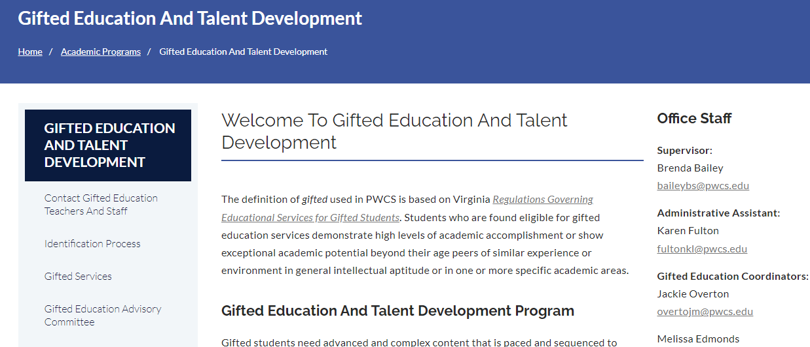
Questions?
Contact the Gifted Resource Teacher at your child's school.
www.pwcs.edu → Families → Academic Programs → Gifted Education and Talent Development
​
​
​

Slide 57
Questions/Answers

Slide 58
Work Session
Positive Climate and Culture: Safety and Attendance

